Slide 1

Laptop Data Analysis
By
MOHAMMED SUHAIL M R

Slide 2
Introduction :
The laptop dataset comprises various attributes related to laptops, including manufacturer,
specifications, and pricing information. The goal of this project is to conduct a comprehensive
analysis of the dataset to derive insights into laptop characteristics, performance, and pricing,
catering to both consumers and manufacturers in the computer industry.
Importance of Data Understanding In Laptop Dataset:
Company Name & Type Name: Helps categorize laptops by brand (e.g., Dell, HP) and type (e.g., Ultrabook, Notebook).
Screen Size & Resolution: Crucial for usability and visual quality (e.g., 15.6 inches, Full HD).
CPU, RAM, GPU: Key performance indicators (e.g., Intel i5, 16GB RAM, NVIDIA GTX 1650).
Memory & Weight: Storage and portability factors (e.g., 512GB SSD, 1.2 kg).
Price (INR): Primary customer decision factor (e.g., ₹75,000). Understanding these features aids analysis and insights.

Slide 3
Work flow :
DATA IMPORT AND INITIAL CHECK
DATA CLEANING
EXPLORATORY DATA ANALYSIS [EDA]
INITIAL EXPLORATION:
Insights from Initial Exploration:
Missing Values:
Identified columns with missing values during the initial analysis.
Missing values were addressed by removing rows with incomplete data.
Duplicates:
Duplicate records were detected and removed to ensure data integrity.
Outliers:
Observed unusual data points in features like Weight and Price during statistical analysis.
Weight ranged from 1 kg to 4.5 kg, and prices varied widely between $500 and $5000.
Patterns:
RAM & Storage: The majority of laptops had 16 GB RAM and 512 GB storage.
Price Trends: Higher specifications correlated with increased prices, as expected.

Slide 4
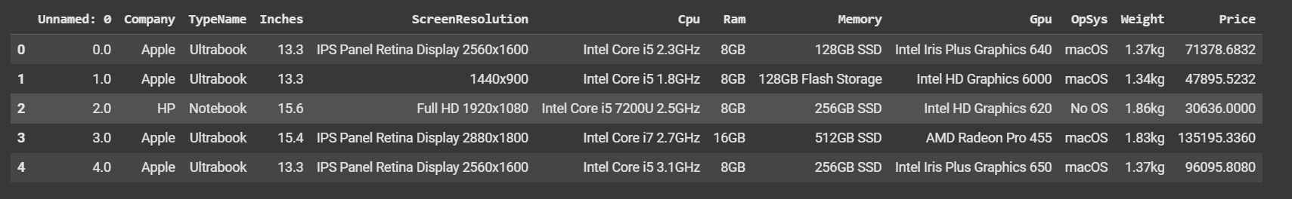
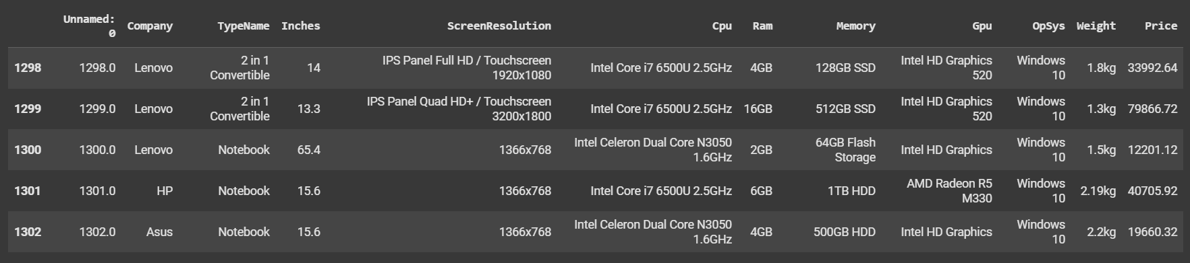
DATA SET:
DATA SET FOR LAPTOP DATA ANALYSIS :
DATA HEAD :
DATA TAIL :

Slide 5
Data understanding:
Number of rows :1303
Number of columns :12
Data type : Int,Float,Object

Slide 6
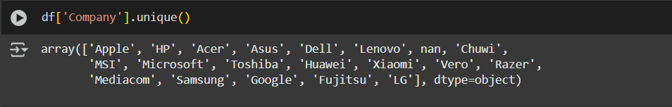
Companies :
Apple
HP
Acer
Asus
Dell
Lenovo
Chuwi
MSI
LG
Microsoft
Toshiba
Huawei
Xiaomi
Vero
Razer
Mediacom
Samsung
Google

Slide 7
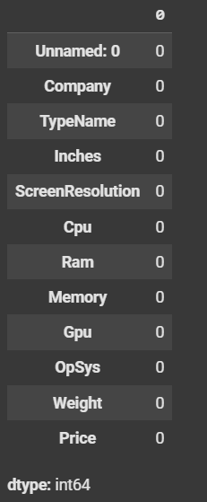
Exploration :

Slide 8
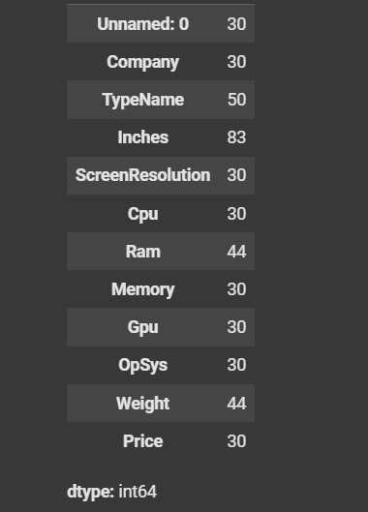
Missing values : there is a missing values in the data

Slide 9
Exploratory data analysis (EDA) : data visualization :
Overview of EDA Techniques:
Data Cleaning: Addressed missing values, standardized formats, and resolved inconsistencies.
Univariate Analysis: Explored individual features using histograms and box plots.
Bivariate Analysis: Investigated relationships between two variables with scatter plots and bar charts.
Multivariate Analysis: Explored interactions among variables using heatmaps and pair plots.

Slide 10
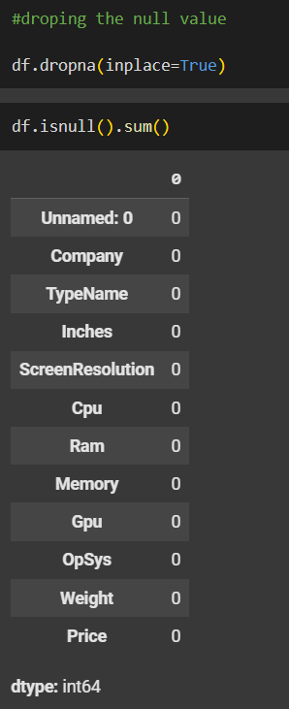
Data cleaning process :
Missing Values Handling :
Detection of missing values:
Used the isnull().sum() function to identify missing values in the dataset.
Columns with missing values were noted, and their impact on analysis was assessed.
Handling missing values :
Rows with missing data were removed using dropna() to ensure a clean dataset.
BEFORE:
Number of rows: 1303 (initial dataset size).
Missing values were present in key columns.
AFTER:
Number of rows: 1173 (after removing incomplete rows).
Dataset cleaned, ready for further analysis.

Slide 11
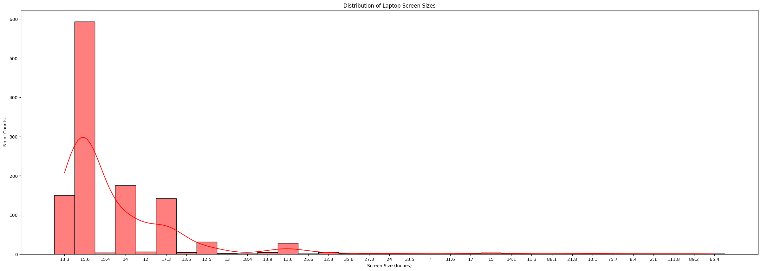
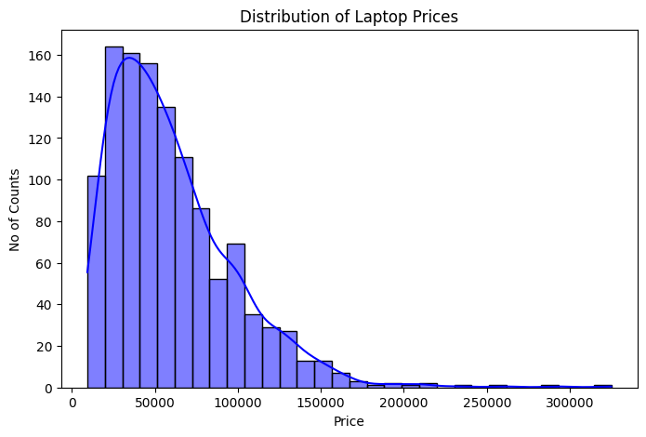
univariate analysis : Explored individual features using histograms :

Slide 12
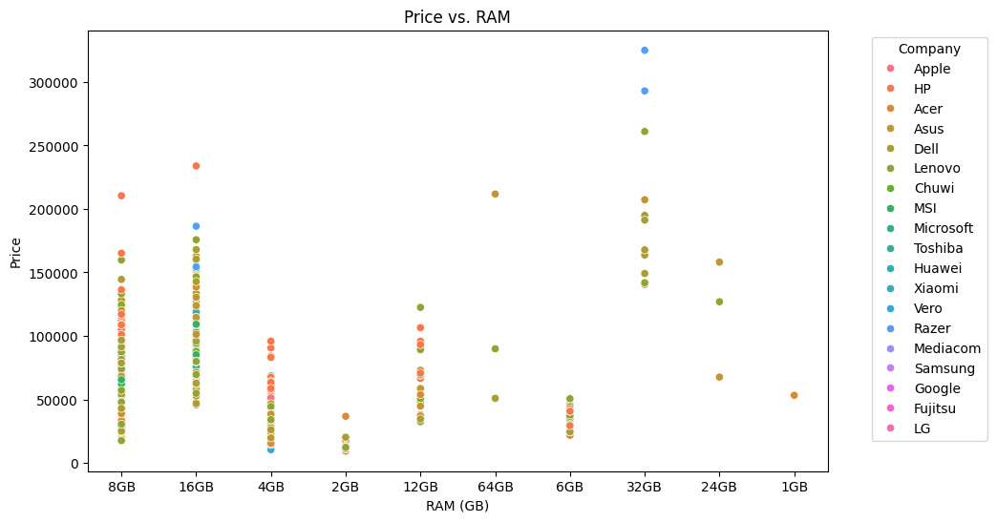
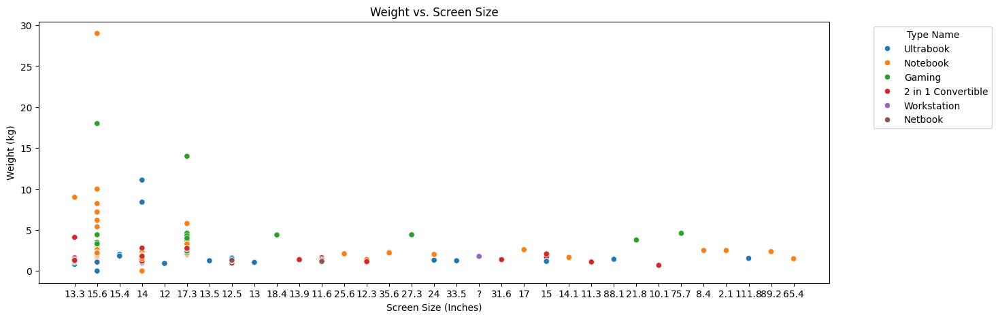
Bivariate Analysis : Investigated relationships between two variables with scatter plots

Slide 13
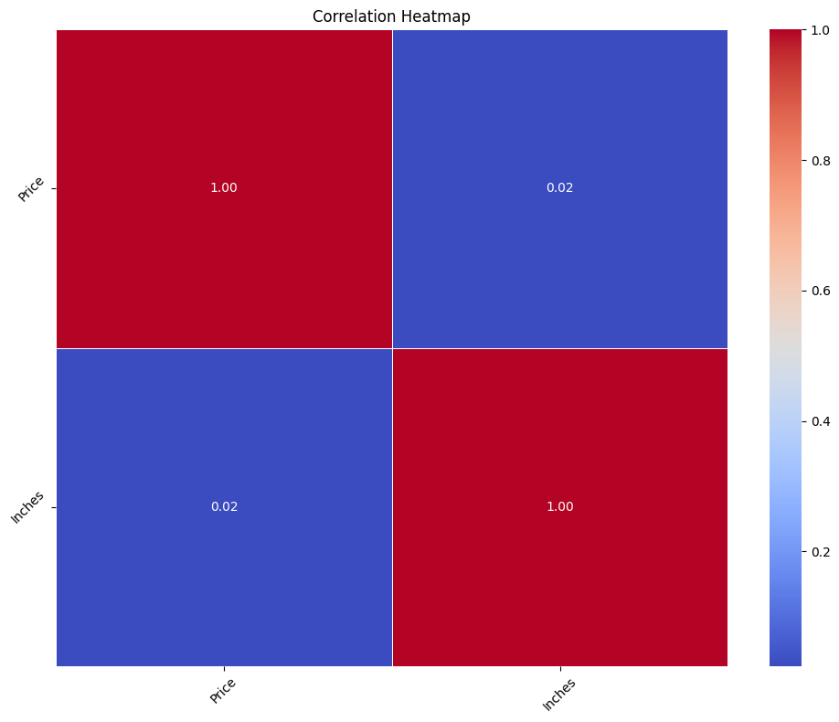
Multivariate Analysis: Explored interactions among variables using heatmaps and pair plots.

Slide 14
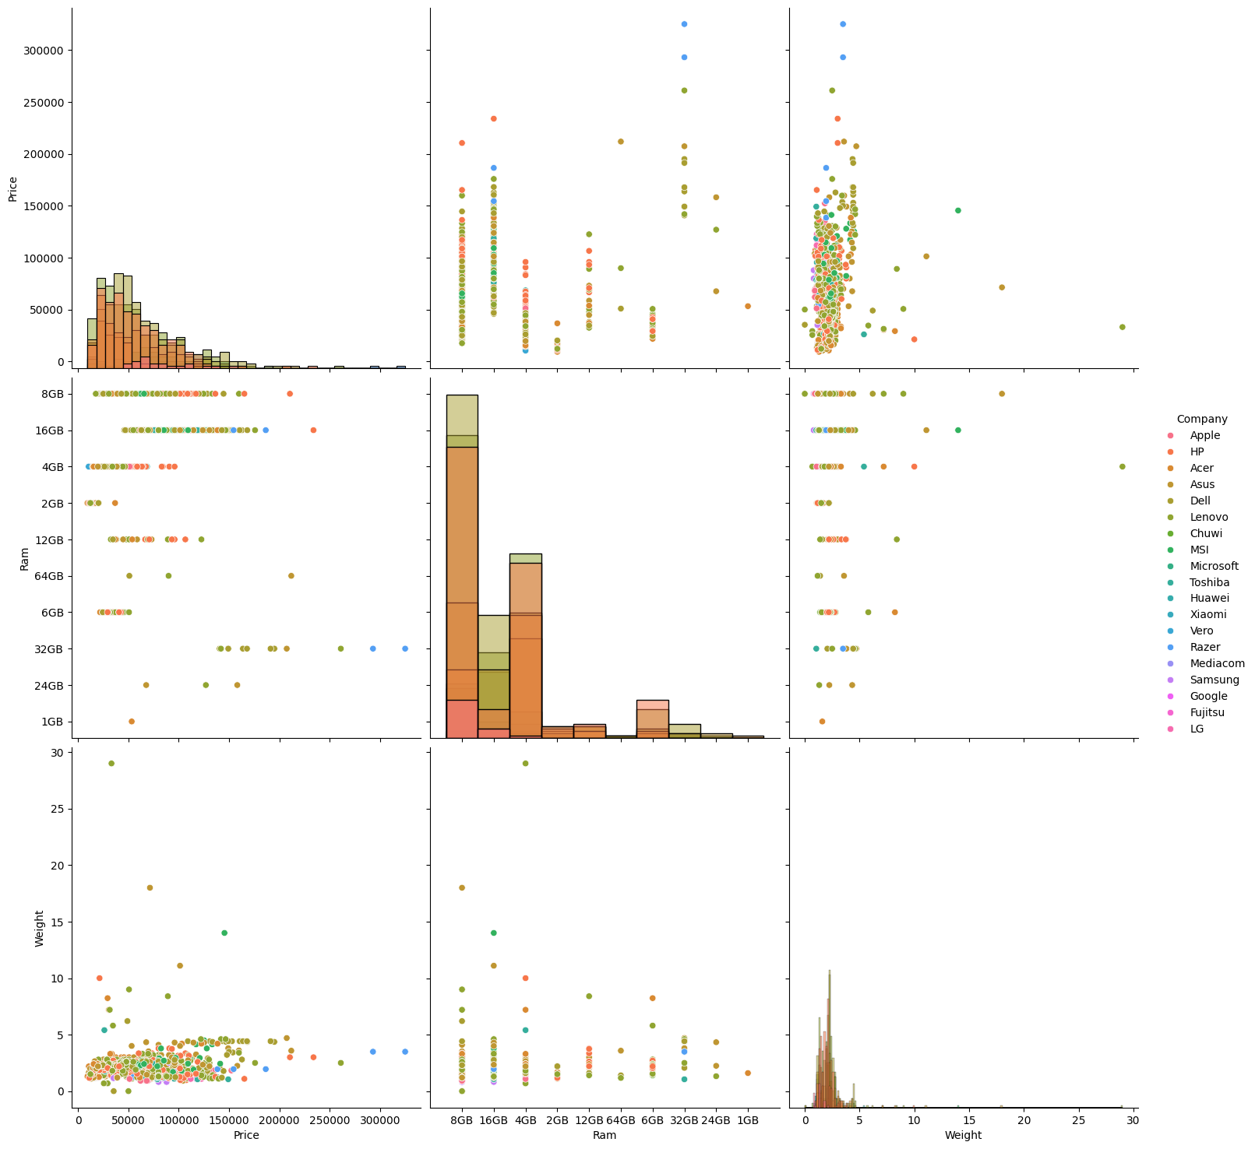
Pair plot’s :
PAIR PLOT’S

Slide 15
CONCLUSION :
the eda reveals clear trends in pricing, brand dominance, and feature correlations. laptops priced under 1lakh’s dominate the market, with strong preferences for specific brands. feature relationships, such as higher ram correlating with increased price, can guide product positioning. value-for-money laptops (mid-price, high ratings) are key drivers of customer satisfaction.
data analysis reveals several key trends and insights that can guide both consumers and manufacturers. high-performance laptops, especially those with strong cpu and battery life, continue to dominate the market, with brands like model apple ,hp ,acer ,etc leading in overall performance.
THANK YOU !!!

